Slide 1
Programming II
(C Programming Language)
Type Casting in C
Lecture 21, Monday April 26, 2021
Dr. Ayman ALJARBOUH

Slide 2
Outline
Type Casting in C Programming
Integer Promotion
Implicit Type Casting
Arithmetic Conversion Hierarchy
Explicit Type Casting

Slide 3
Type Casting in C Programming
Typecasting is converting one data type into another one
It is also called as data conversion or type conversion
It is one of the important concepts introduced in C programming language
C programming language provides two types of type casting operations:
Implicit type casting
Explicit type casting

Slide 4
Outline
Type Casting in C Programming
Integer Promotion
Implicit Type Casting
Arithmetic Conversion Hierarchy
Explicit Type Casting

Slide 5
Implicit Type Casting
Implicit type casting means conversion of data types without losing its original meaning
This type of typecasting is essential when you want to change data types without changing the significance of the values stored inside the variable
Implicit type conversion happens automatically when a value is copied to its compatible data type
During conversion, strict rules for type conversion are applied
If the operands are of two different data types, then an operand having lower data type is automatically converted into a higher data type

Slide 6
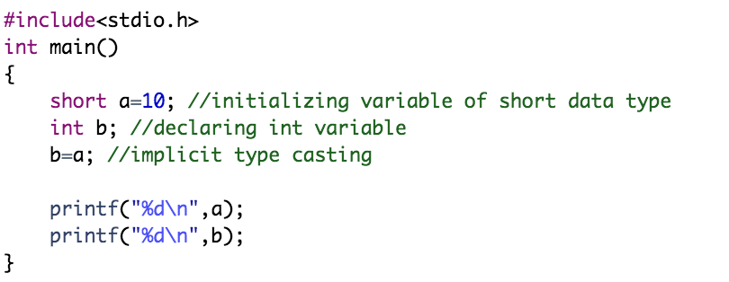
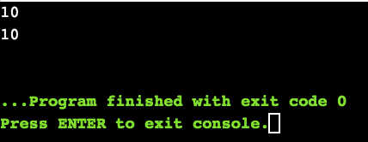
Implicit Type Casting
The following examples demonstrate the implicit type casting
Example:
We have declared a variable a of short data type with value initialized as 10

Slide 7
Implicit Type Casting
The following examples demonstrate the implicit type casting
Example:
On the second line, we have declared a variable b of an int data type

Slide 8
Implicit Type Casting
The following examples demonstrate the implicit type casting
Example:
On the third line, we have assigned the value of variable a to the variable b. Implicit type conversion is performed as the value from variable a which is of short data type is copied into the variable b which is of an int data type

Slide 9
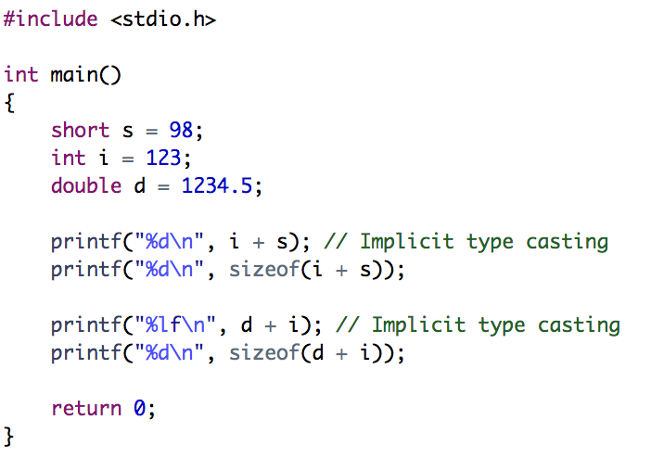
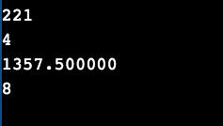
Implicit Type Casting
The following examples demonstrate the implicit type casting
Example:

Slide 10
Outline
Type Casting in C Programming
Integer Promotion
Implicit Type Casting
Arithmetic Conversion Hierarchy
Explicit Type Casting

Slide 11
Integer Promotion
Integer promotion can be seen as an implicit type casting
Some data types like char, short int take less number of bytes than int, these data types are automatically promoted to int or unsigned int when an operation is performed on them. This is called integer promotion
Integer promotion of values of type "smaller" than integer int is done automatically by the compiler

Slide 12
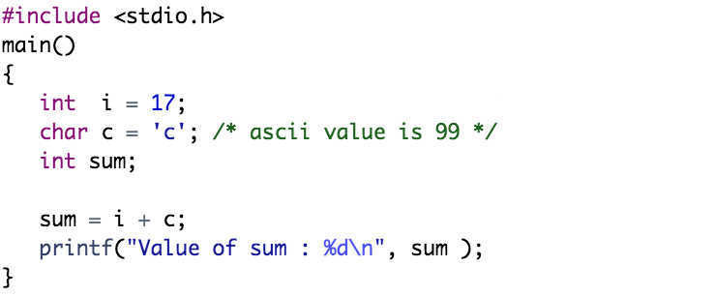
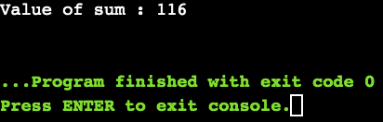
Integer Promotion
The following example demonstrates this type of type conversion
Example:
The value of the integer variable sum is coming as 116 because the compiler is doing integer promotion and converting the value of the character variable c to ASCII before performing actual addition operation. So, the value of c is promoted to type integer

Slide 13
Outline
Type Casting in C Programming
Integer Promotion
Implicit Type Casting
Arithmetic Conversion Hierarchy
Explicit Type Casting

Slide 14
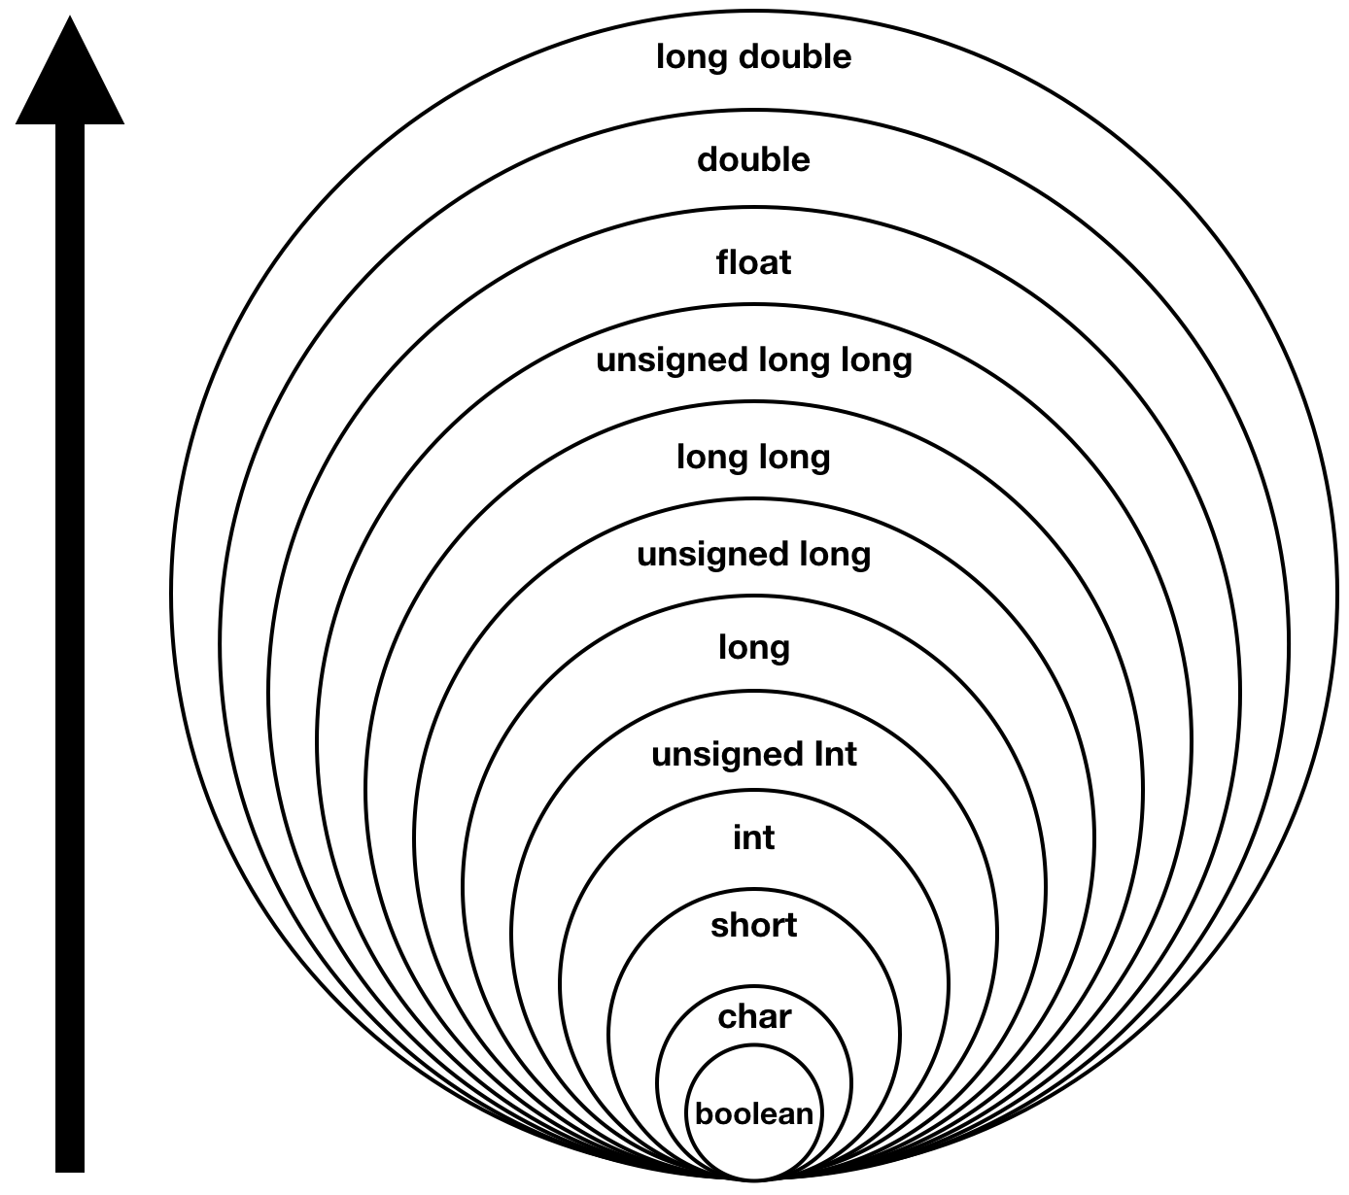
Arithmetic Conversion Hierarchy
The compiler first performs integer promotion. If operands still have different types, then they are converted to the type that appears highest in the following hierarchy chart

Slide 15
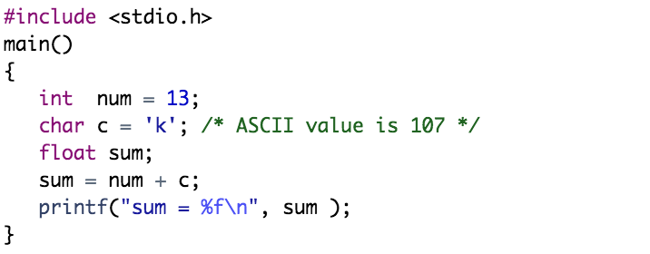
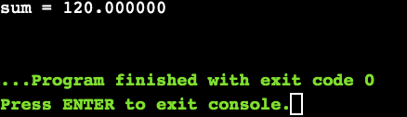
Arithmetic Conversion Hierarchy
The following example demonstrates this concept
Example:
In the above code, first the character variable c gets converted to integer, but because final value is float, so arithmetic conversion applies, and the compiler converts num and c into float and adds them, yielding a float result

Slide 16
Important Points about Implicit Conversions
Implicit type of type conversion is also called as standard type conversion
Converting from smaller data type into larger data type is called as type promotion
The implicit type conversion always happens with the data types that are compatible with each other
We cannot perform implicit type casting on data types which are not compatible with each other, such as:
Converting float to int will truncate the fraction part, losing the meaning of the value
Converting double to float will round up the digits
Converting long int to int will cause dropping of excess high order bits
In all the above cases, when we convert the data types, the value will lose its meaning. The loss of meaning of the value is warned by the compiler

Slide 17
Outline
Type Casting in C Programming
Integer Promotion
Implicit Type Casting
Arithmetic Conversion Hierarchy
Explicit Type Casting

Slide 18

Explicit Type Casting
In implicit type conversion, the data type is converted automatically. There are some scenarios in which we may have to force type conversion
Suppose we have a variable that stores the division of two operands var1 and var2 which are declared as an int data type
In this case, after the division performed on variables var1 and var2, the result stored in the variable result will be in an integer format
Whenever this happens, the value stored in the variable result loses its meaning because it does not consider the fraction part which is normally obtained in the division of two numbers

Slide 19

Explicit Type Casting
To force the type conversion in such situations, we use explicit type casting
Explicit type casting It requires a type casting operator
The general syntax for type casting operations is as follows
where type-name is a standard C data type, and expression can be a constant, a variable or an actual expression

Slide 20
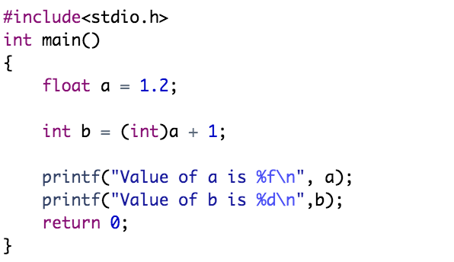
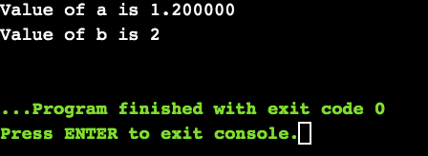
Explicit Type Casting
Example:
We have initialized a variable a of type float
Next, we have another variable b of integer data type
We have typecast the variable a of type float. By using explicit type casting methods, we have successfully converted float into data type int
We have printed value of a which is still a float
After typecasting, the result will always be an integer b

Slide 21
Practical Exercises
Write and Compile the following C programs:
Program 1:

Slide 22
Practical Exercises
Write and Compile the following C programs:
Program 2:

Slide 23
Practical Exercises
Write and Compile the following C programs:
Program 3:

Slide 24
Practical Exercises
Write and Compile the following C programs:
Program 4:

